Slide 1
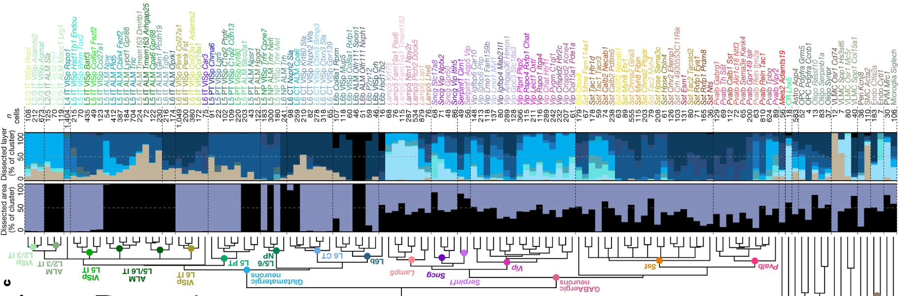
Predicting Neuronal Cell Types from scRNAseq data
Group 6: Dania Annuar, Caichen Duan, Yijie Kang, Jiaxing Liu

Slide 2
Overview
Challenge: generate machine learning model(s) to annotate neuron cell types for the Patch-Seq data!
Integrating this wealth of data with morphology and physiology, for the comprehensive study of neuronal biology, requires multiplexing gene expression data with complementary techniques → development of Patch-seq!
The passage of the patch-pipette through the processes of adjacent cells cause off-target cell-type mRNA contamination in patch-seq
Why important?
Using machine learning model to predict cell types and present the level of contamination within the samples.
Notes:
Before goes into our Analysis, we first review our challenge background in short
x`x`x`...
Talk about the region - and cell types we have

Slide 3
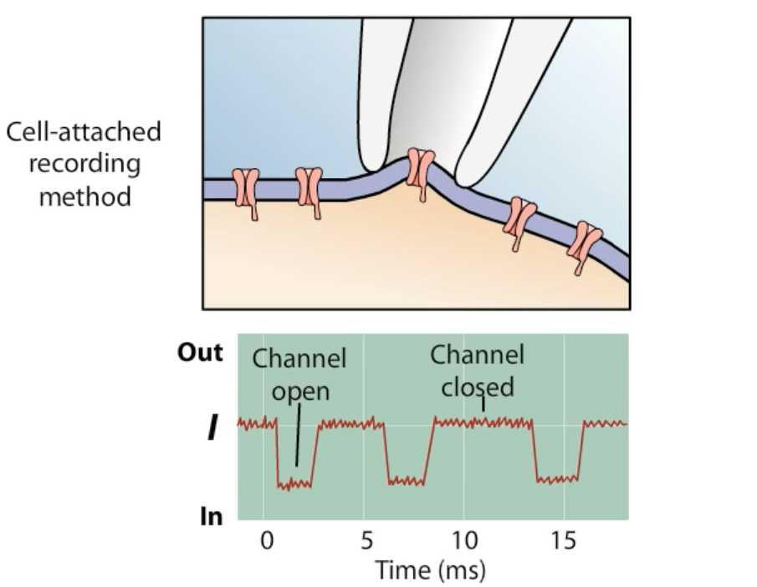

Slide 4
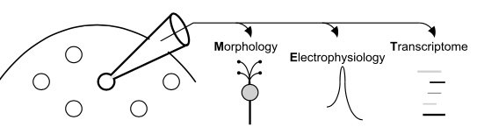
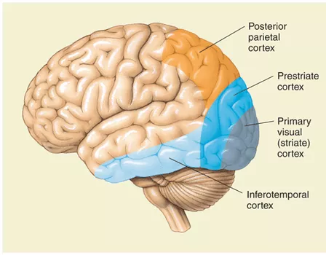

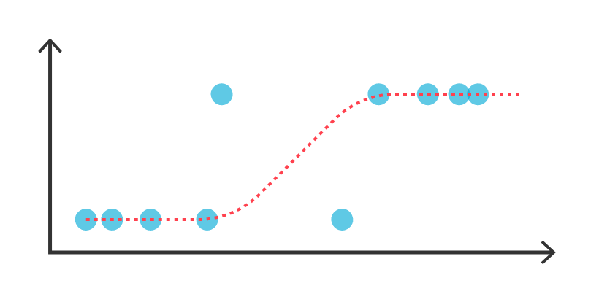
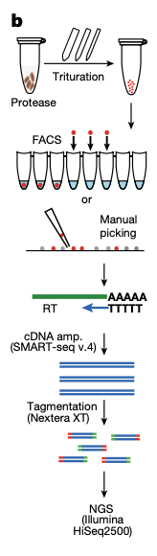
Patch seq data
Predicted neuron cell types
With the contamin-ation levels
Gene:45,768
Sample:4,435
Training model
Similarity of our dataset
mouse model
Position: primary visual sensory cortex （VISp)
Cell group: GABAergic neurons
Data: RNA-seq with same sequencing platform and workflow
80% of data for training
Models
Traditional RNA seq data
Balanced vs imbalanced
Regularized vs unregularized
…
20% of data for test
Gene:45,768
Sample:15,413
Notes:
How to make balance data

Slide 5
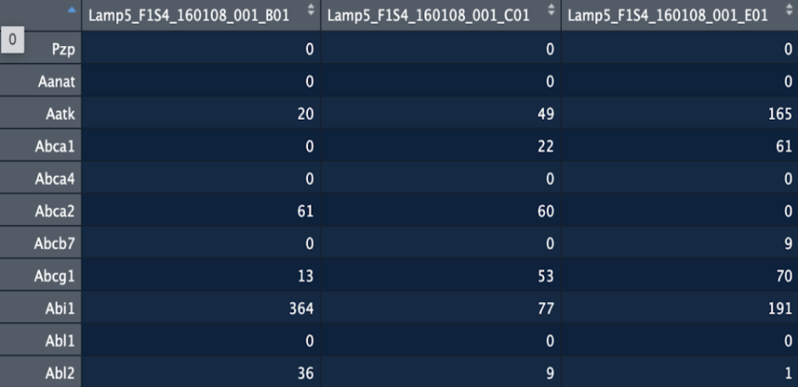
Data structure -- Gene counts by sample (2018)
Samples
(15,413)
Gene
(45,768)

Slide 6
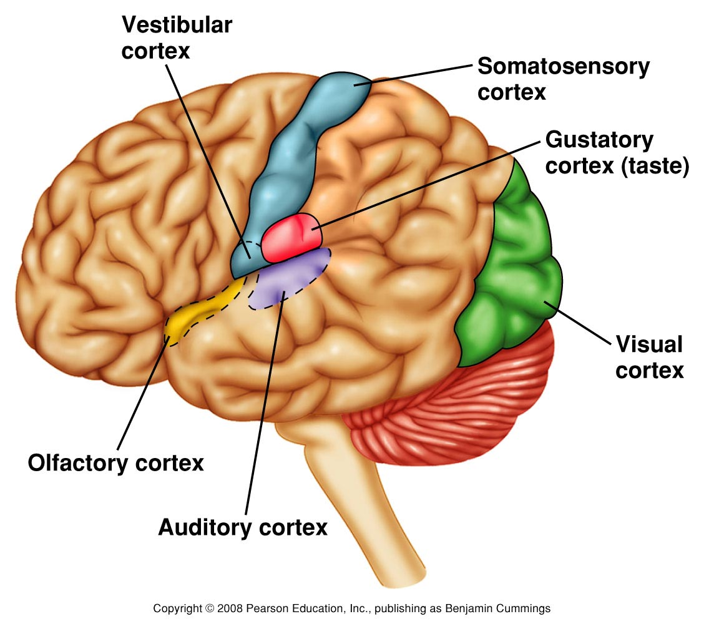
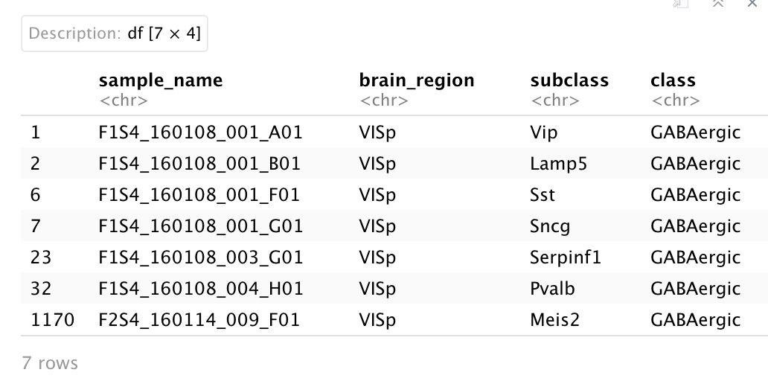
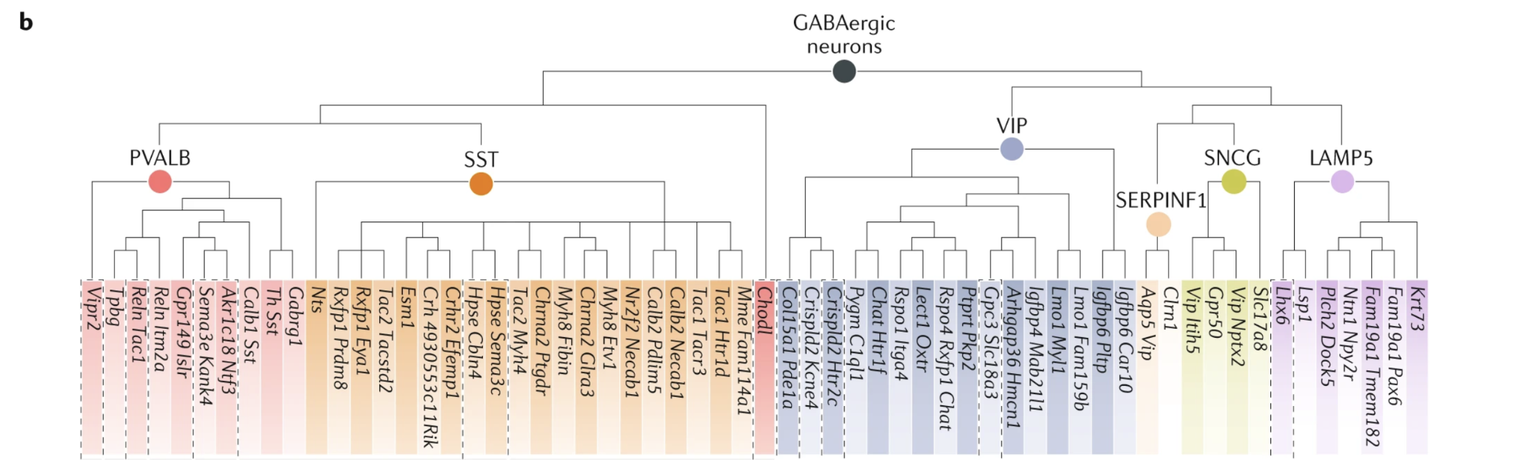
Cell types - why we can predict one from the other
GABAergic neurons: inhibitory neurons
VISp: primary visual sensory cortex area
Notes:
As 2020 paper detected GABAergic neurons in VISp area, we used the GABAergic neurons in the same area from 2018 paper to build our model and evaluate the model.

Slide 7
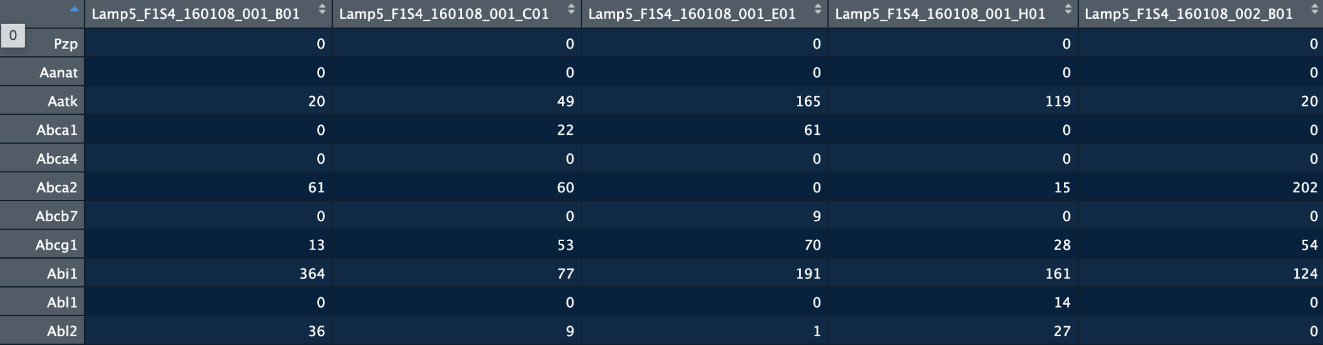

Slide 8
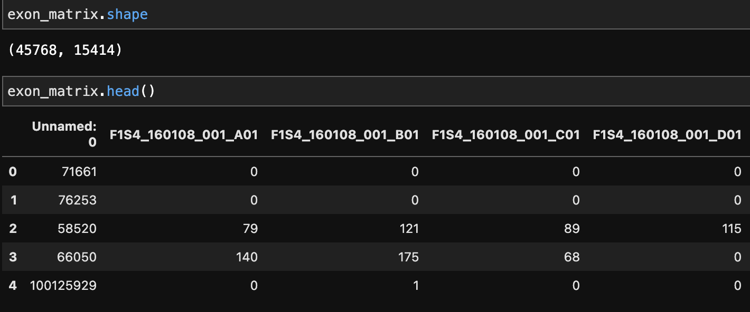
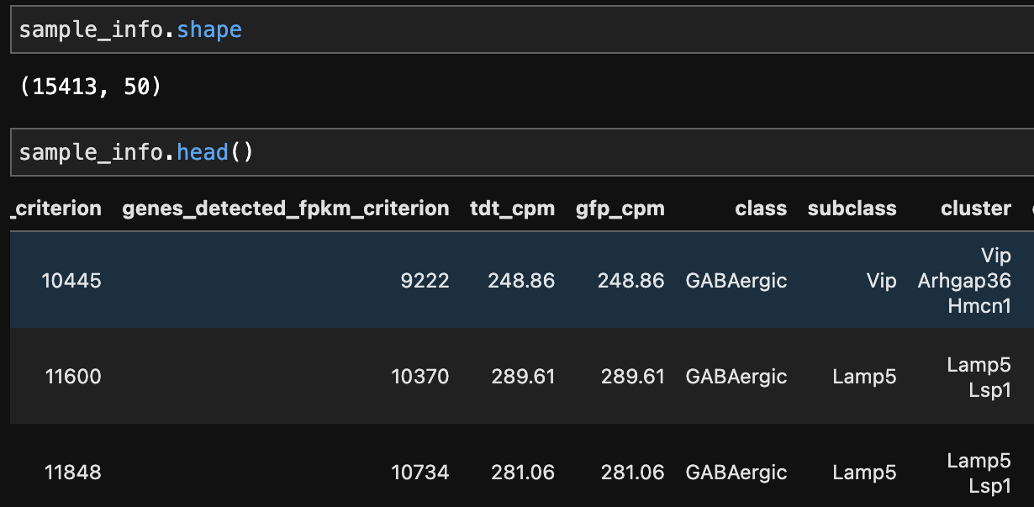
The dataset
Origin of data
High-quality dissociation-based scRNAseq data (Tasic et al, 2018) → Training data set to build and test model
Patch-seq data (Gouwens et al, 2020) → Data to predict cell type
Data structure of 2018 training data
Gene expression data matrices
Exon count matrix: matrix of read counts obtained for each (gene, sample/cell) based on alignment to exons
Intron count matrix: matrix of read counts obtained for each (gene, sample/cell) based on alignment to introns
Row x column = gene identifiers x cell identifier
Sample information matrix
Contains information for each cell, including cell type in “cluster” column
Row x column = cell x sample features
The expression values of genes within each cell will be the features used to build our model in predicting cell type
Sample/cell identifier
gene identifier
Read counts/
expression values
Sample/cell features
Sample/cell identifier
Notes:
2018 paper: Uses scRNAseq to look at the diversity of cell types across mouse neocortex, including the primary visual cortex (VISp) - which we’re only interested in using for the Patch-seq data prediction
2020 paper: what we’ll use our model for. Introduces the new Patch-seq method that was explained earlier. We’re going to use the transciptomic data from scRNAseq and predict the cell type using our model.
What does the data look like?
Our data structure mainly comprises of 2 types of matrices:
1st : Gene exp data matrices - split into
Exon count matrix: Basically a matrix of read counts obtained from scRNAseq for every gene in every cell, based on the alignment to exons
Intron count matrix: Same, but it’s based on the alignment to INTRONS
Row = each gene, column = each cell/sample
2nd: Sample information matrix
Contains information for each cell. So as you can see, the number of cells in the previous gene expression data matrix is consistent with the n of cells in the sample info matrix -- which is 15413 cells. So each row represents a cell, and the columns are specific features related to that cell.
In the 2018 paper, their analysis of their scRNAseq data already provided us with the cell type assignments which is in the “cluster” column (in that box in red). We already know what the cell types are for the training data.
And so, the expression values of genes within each cell will be the features used to build our model in predicting cell type in 2020 data..

Slide 9
Our analysis pipeline
scRNAseq analysis (Seurat)
Quality control
Normalization
Reduce systematic bias by CPM
Feature selection
Find high variance genes
Dimensionality reduction - PCA
Model selection and performance evaluation
AUC curves
Test models on simulated contaminated data
Evaluating our prediction
Compare PCA plots
Questions and next step
Notes:
Brief overview of what we did:
First,analzed our sequeuncing data – used Seurat (a package to perform this analysis) - and it does QC, normalization, feature selection and dimensionality reduction.
Important thing to note is that we’re only choosing high variance genes for downstream analysis and to train our models
Then, we’ll move on to the ML part –
We split our data into train and test , then we used Logistic regression and RF. And evaluated these models using AUC curves.
In addition, because the aim of this predictive modEL is to solve the contamination problem created by PAtch-seq, we simulated contaminated data and evaluarted how our models performed with that data
Then we tried to evaluate our predictions by comparing PCA plots between the 2018 and 2020 data set

Slide 10
STEPS
Brief overview - background , our data set - why they are similar , challenges, (ending in PCA for training set )
Seurat - analysis steps (edit slide)
Models:
Random Forest
Multiple logistic regression (balanced vs unbalanced)
Predicted probablities, AUC curves
Confusion matrix heatmap
How we picked the best model:
AUC curves
Contamination simulation to decide model
Compare PCAs and UMAP of 2018 and 2020 after prediction
To show that the data can be clustered similarly for 2020. Clusters are similar
Our Questions based on what we get:
How to set contamination threshold? - as next step
What other ways to prove similarity between the 2 datasets

Slide 11
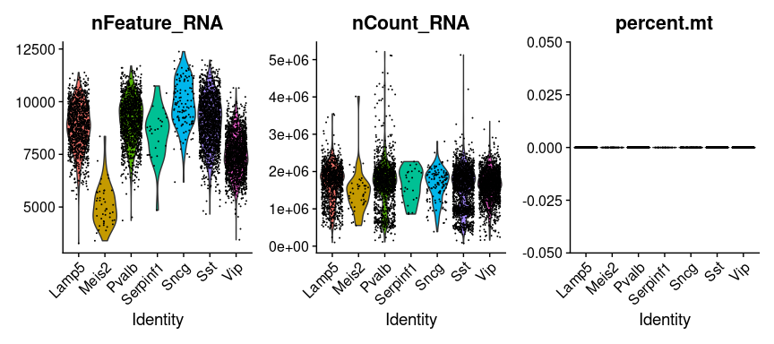
Quality control
Looking at distributions in data and removing low quality cells from analysis
Number of genes detected across cell types
Total counts/number of molecules originating from each cell type
Each cell type received similar n of reads
Low quality cells or few cells = few genes (Meis2, Serpinf1, Sncg)
Percentage of reads mapping to mitochondrial genome
Low quality/dying cells have high mitochondrially derived genes. Here, seems like % is negligible
1 2 3
Notes:
QC step is just looking at distributions in data and removing low quality cells from analysis
We looked at n of genes detected across cell types --- plot , total counts --- plot and % reads mapped to mitochondrial genome --- plot
Explain 1 - distribution of genes detected in each cell type
Explain 2 - shows that each cell received similar n of reads
Might be important to note for our downstream analysis - where our model might not be able to predict these cell types accurately due to the low n of features. And we sort of see that 2 of these genes do not separate well, but overlap with other clusters in our dimensionality reduction part…
Explain 3 -
If cells are dead, you would see more mitochondrial genes
If gene name start with ml, get rid of it

Slide 12
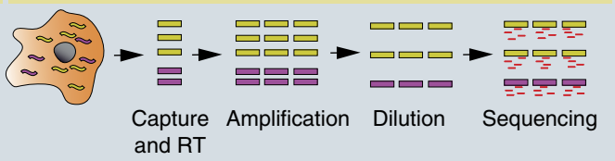
Normalization
Technical noise is introduced in each step:
We chose log-counts per million (logCPM) since it’s clear and an easy way to normalize. This paper also used CPM to normalize.
But if we find that our model performs bad, we might need to do a more careful and complex normalization - changing size factor that represents these biases
logCPM = log(reads or counts mapped to gene * 10^6 / total reads mapped to the cell )
Notes:
Normalization - to reduce technical intodurced during our workflow
In scRNA seq, there are multiple steps, and noise is introduced in every step, so we need to account for that
We chose CPM
CPM = read counts per gene / total number of counts

Slide 13
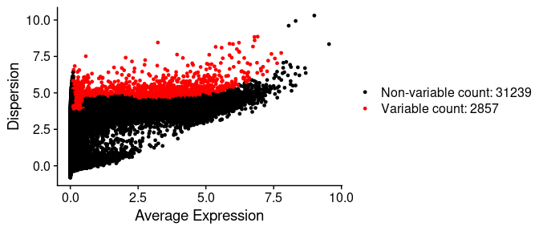
Feature selection: Selecting highly variable genes
Identifying highly variable genes
Mean-variance plot: plotting the variance of each gene expression across all cells
It is used to select genes that contain useful biological information while removing genes that contain random noise and to reduce dimensionality for computational efficiency
Selecting highly variable genes
Fitted line can be drawn on the plot to show an estimate of variance due to technical noise
Anything above the fitted could be selected
Playing around with mean-variance trade-off - might have to choose another method or cutoff if ML model does not perform well
2857 genes were selected to be highly variable, and that will be the amount of features moving forward - dimensionality reduction, clustering and ML modeling
each point is a gene
Notes:
How we select features is by selecting highly variable genes -
We identify highly variable genes using the mean-variance plot where we plot variance of each gene expression across all cells
Then we need to select highly variable genes:
So a fitted line can be drawn on the plot showing an estimate of variance due to technical noise
Mean - variance trade off -- if we select more genes, we would increase the variance but reduce bias and vice versa
Select 2857
Dispersion = variance
Genes with the largest variances in log-values will contribute most to the Euclidean distances between cells during dimensionality reduction and clustering

Slide 14
Dimensionality reduction - PCA
The dimensions are still high after selecting high variance gene.
2857 features left after selection
Perform PCA to further reduce dimension.
PCs are extracted to explain variance of the variables

Slide 15
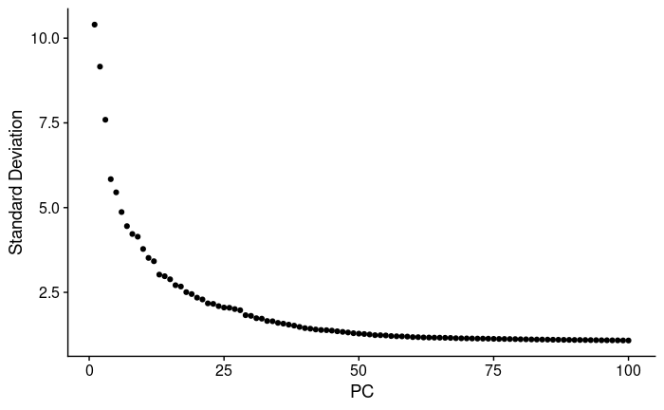
Dimensionality reduction - Scree plot
PCs
We then performed PCA using selected high variance genes.
Plotted scree plot to choose number of PCs.
The difference on variance between each PC becomes small after 30.
Chose the first 30 PCs with high variance.
Notes:
the percentage of variance explained by each one
M’ by n’: M’ should be the number of PCs we chosen… n’ is the number of cells that passed the quality control.

Slide 16
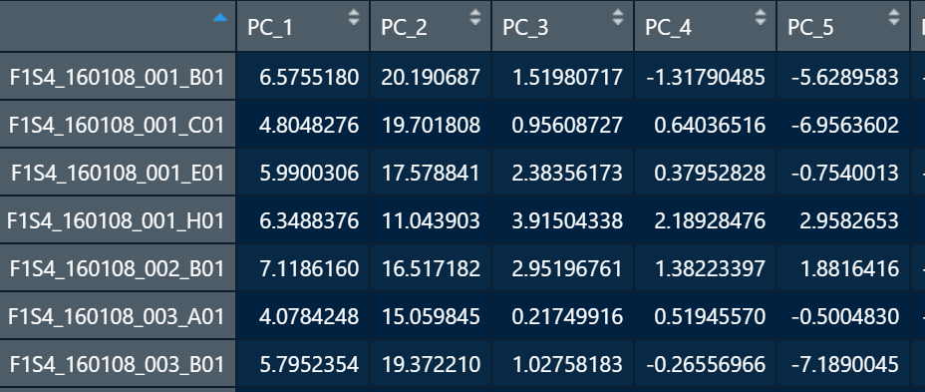
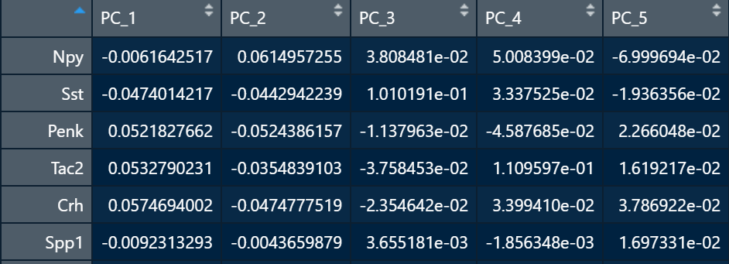
Results from PCA: Embedding & feature loading tables
Cell embeddings
Feature loadings
Stores the coordinates for each cell in low-dimensional space.
Transformed data for model building.
Stores the weight for each feature along each dimension of the embedding
Saved to transform data used for prediction.
High-dimensional data with hvgs
2857*6125
Data embedded in to low-dimensional space
6125*30
Feature loading
2857*30
Terminology alert!
Feature loading = Eigenvector*sqrt(Eigenvalue)
Notes:
We just wanted to show results from out PCA:
By running PCa on our data we got 2 important tables that we used moving forward. The first is cell embedding and second is feature loading.
Cell embeddings: Stores the coordinates for each cell in low-dimensional space.
The second one is feature loadings table: Stores the weight for each feature along each dimension. Or the eigenvalues and eigenvectors used for the transformation of our data.
These values were used to transform the 2020 data we will use prediction.
6125 = n of cells
2857 = n of high variance genes

Slide 17
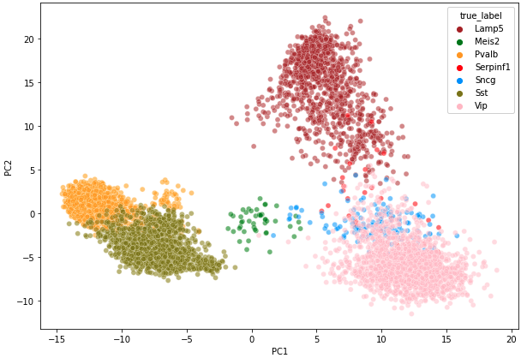
First two PCs for 2018 dataset
Notes:
Data can be separated well enough
Note that we have 7 different cell types - Our model will be used to predict these 7 cell types within our 2020 dataset

Slide 18
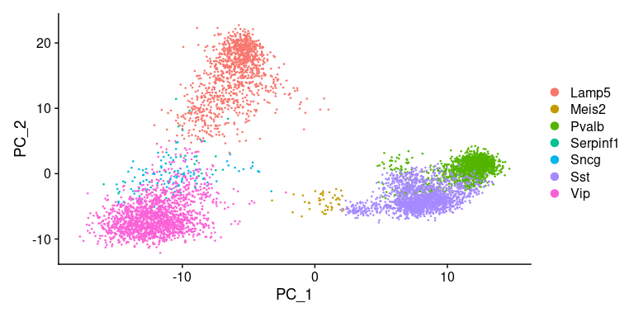
Visualization - the first 2 PCs
Cell type
Our dataset contains 7 cell types
Sncg overlaps with other cell types here
Notes:
We already know the cell types, so we want to see if PCA and UMAP can do well in clustering and differentiating between each cell types - and they did! So we can use dimensionality reduction in our test set such that we don’t lose information
Both cells and features are ordered according to their PCA scores.
# Shall we add the pcs’ heatmap plot here for further explanation?
Sncg and Serpinf1 overlaps with another clusters and do not separate well here - probably because n of features low for these cells, and we’re using only 2 principal components here capturing features w highest variance. The variance of genes in these cells might not be captured in these 2 PCs but other higher PCs.
Meis2 on the other hand still sepatrates well - the genes in Meis2 might be have high variance and included in the first 2 PCs

Slide 19
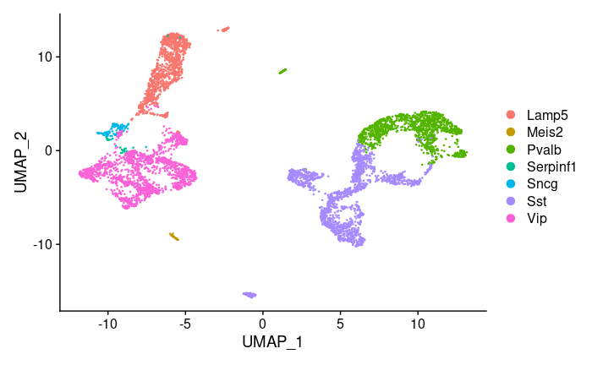
Visualization - UMAP of the first 30 PCs
UMAP of the first 30 PCs
No obvious overlap
Data after dimension reduction keeps information to separate different cell types

Slide 20
What we did What to do
Interpreting raw data
Quality control
Normalization
Feature selection
Selected feature with high variance.
Dimensionality reduction
Used PCA analysis and tuned the parameter with scree plot.
Separate the transformed data from PCA into training and testing set.
Train classification model with training set.
Random Forest, etc
Evaluate model with testing set.
Transform the data from 2020 paper and predict with trained model to get annotation.
Notes:
Cnn
Recurrent neural networks
Multiple regression
Random forest
Rerun the analysis on the 2020 paper till PCA, plot the 2020’s PCA and UMAP to see if it is similar with 2018’s result
Set training data and test data based on 2018 data’s first 30 PCA
Try multiple regression, neural network, random forest in 2018’s data - performance
Test robustness using bootstrap approach
Choose the best ML method for the 2020’s data, predict the cell type

Slide 21
Project Plan
Build model using data from 2018 paper.
Processing data
Randomly pick up 80% data for training and 20% for testing.
Built a classification model with the training data
Train the classifier with different methods for best testing performance. (random forest, NNW, etc.)
Cross-validation
Prediction of data from 2020 paper
Input QC-qualified patch-seq cell data
Predict cell type with built model.

Slide 22
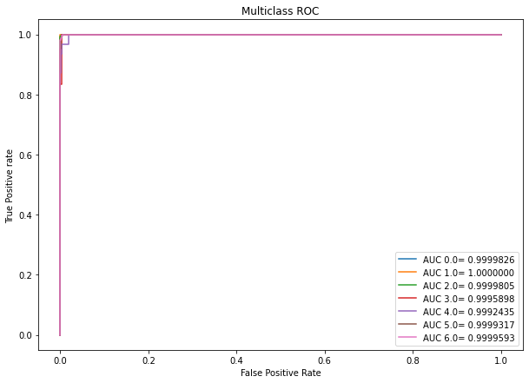
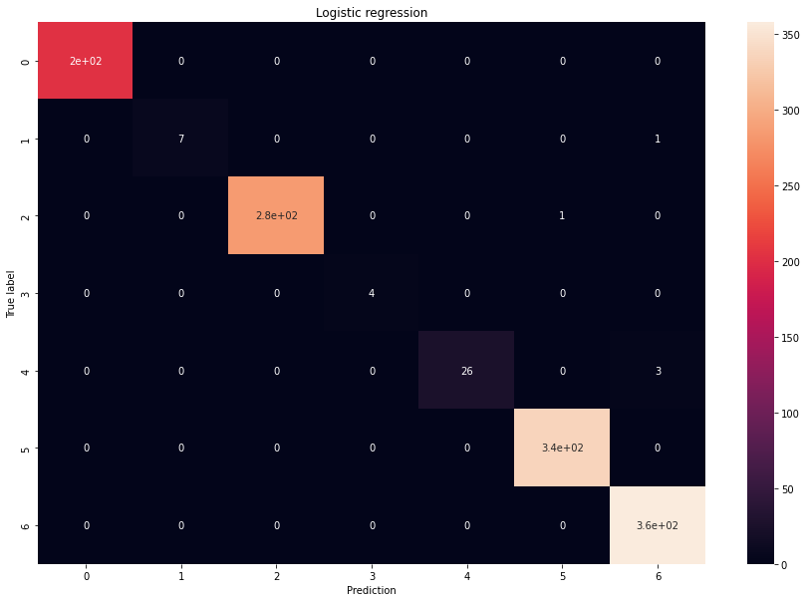
Logistic Regression Model
Use continuous data to predict categorical data.
Multiclass logistic regression model.
Split data into training and testing with test size =0.2
Predict test set
AUC curves
Confusion matrix
Notes:
After we get our pca result, we can use the data for model training. Here we picked up 20% of data to be test set and the rest to be training set. The first model we used is logistic regression. Diagonal speculate

Slide 23

Balanced model
Our data is not balanced.
Build a balanced model to check if there is any improvement.
Confusion matrix and auc show almost the same result as unbalanced model.
The “balanced” mode uses the values of y to automatically adjust weights inversely proportional to class frequencies in the input data as n_samples / (n_classes * np.bincount(y)).

Slide 24


Penalized Logistic Regression Model
Add L1 penalty to regulate the logistic regression model to check if it helps on performance.
Also, similar AUC and confusion
matrix.

Slide 25
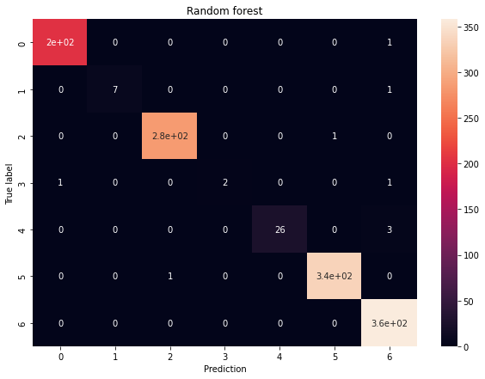
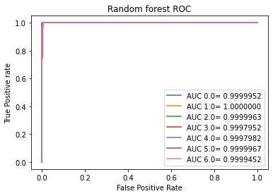
Random Forest
Classification problem
Use RandomForestClassifier()
Balanced and unbalanced model
Predict test set
AUC curves
Confusion matrix

Slide 26
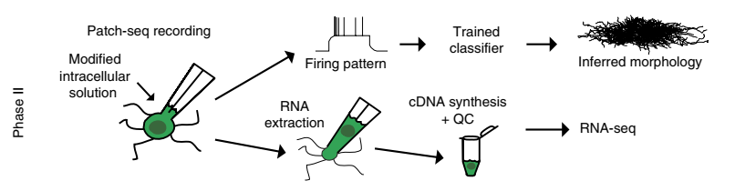
Simulated contaminated cells
Patch-seq has contamination issue
Contamination levels can be inferred by the predicted probabilities for each cell
Histogram of the largest predict probability of each cell
Simulate some contaminated cells:
7 known cell types
Mean of all cells from a pair of 2 different cell types → a simulated contaminated cell
21 simulated contaminated cells as negative control

Slide 27
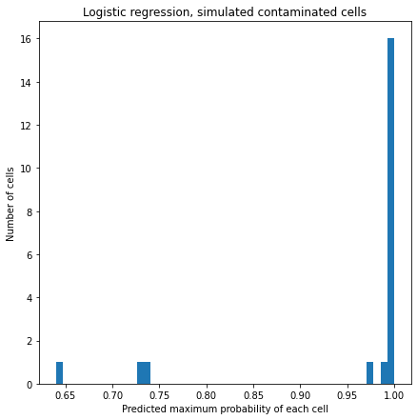
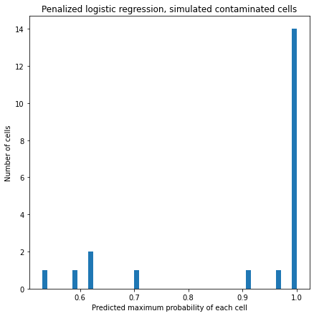
Simulated contamination - Logistic regression
Unpenalized
Penalized

Slide 28
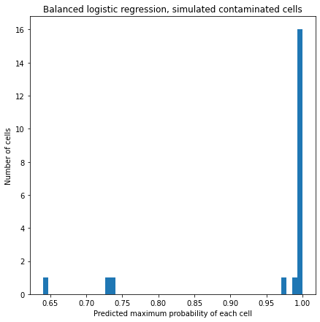
Simulated contamination - Logistic regression
Unbalanced
Balanced

Slide 29
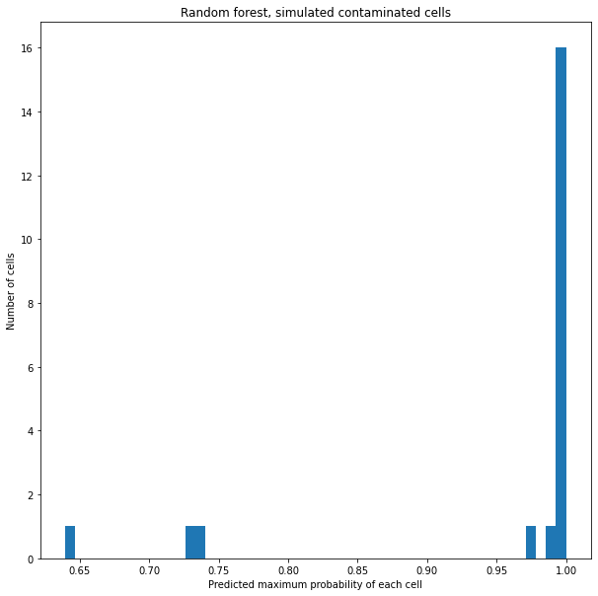

Simulated contamination - Random Forest
Unbalanced
Balanced

Slide 30
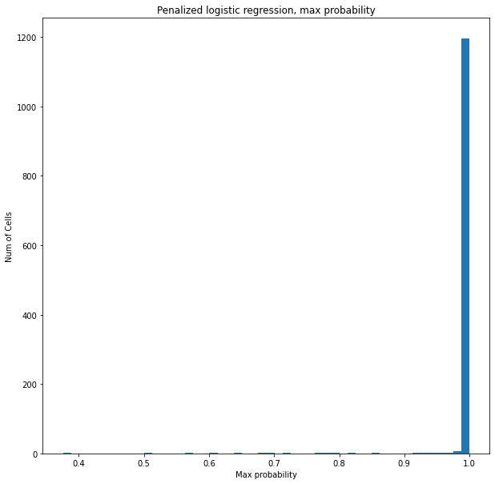
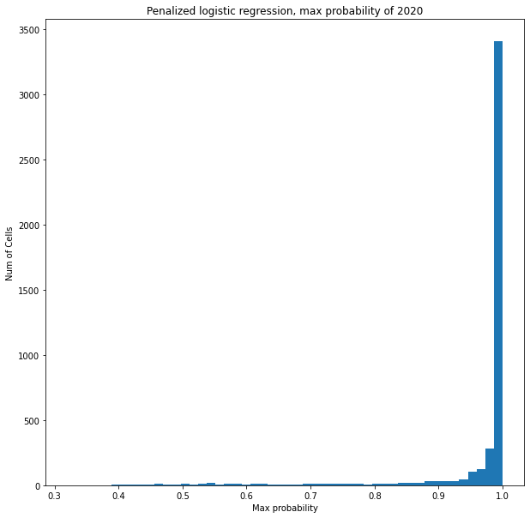
Model Comparison - contamination issue for 2020 dataset
Logistic regression - test set
Logistic regression - 2020 patch-seq data

Slide 31

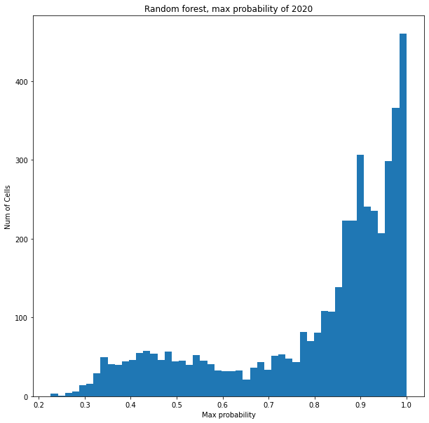
Model Comparison - contamination issue for 2020 dataset
Random forest - test set
Random forest - 2020 patch-seq data
Hypothesis 1: Patch-seq’s RNA sequencing data is not perfect, it has contamination issue
Hypothesis 2: Our model is overfitting for 2018 dataset, it performs worse on 2020 dataset

Slide 32
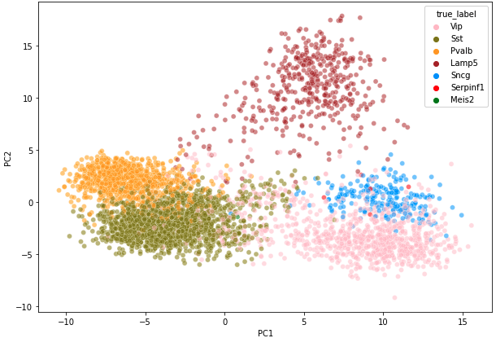
Evaluating Patch-seq dataset and predictions using PCA plot
PCA plots after relabeling the 2020 predicted data set look similar
Proof of concept - our model works for this dataset
Clusters for 2020 data set are more ‘loose’ than 2018
Tasic 2018
Patch-seq 2020
n of cells/samples: 15,413
n of cells/samples: 4435
Notes:
AFter we did the predictions, we wanted to sort of evaluate how it did (since we don’t really know if it’s the correct prediction or not) AND to know if both datasets are similar.. So we reran PCA for our 2020 predicted data. We transformed the 2020 expression values the same way as we did in 2018 .
So, If high dimensional data is similar, low dimensional data looks similar too
So based on this, we see that the two datasets are very similar. Proving that we can use our model to predict this 2020 dataset.
The clusters in 2020 more loose than 2018, which can be explained by the contamination issue in this data
The relationship/distance between each dots wont be changed by PCA transformation. It’ll still be captured. So, if the relationship from the beginning is different than the 2018, then we will also see that after transformation.
Did the data imbalance correct the PCA?

Slide 33
Questions & Next Steps
Questions
How to set contamination threshold?
How to prove the similarity between datasets?
Next Steps
Simulate more contaminated cells and also with more complex sources
Bulide models specifically for contamination issue and filter out contaminated cells before cell type prediction
Filter the patch-seq data with contamination threshold
Add more batches of scRNA-seq dataset to train and test our model
Other methods to check the contamination issue in patch-seq data

Slide 34
Reference
Cadwell C R, Palasantza A, Jiang X, et al. Electrophysiological, transcriptomic and morphologic profiling of single neurons using Patch-seq[J]. Nature biotechnology, 2016, 34(2): 199-203.
Gouwens N W, Sorensen S A, Baftizadeh F, et al. Integrated morphoelectric and transcriptomic classification of cortical GABAergic cells[J]. Cell, 2020, 183(4): 935-953. e19.
Hao Y, Hao S, Andersen-Nissen E, et al. Integrated analysis of multimodal single-cell data[J]. Cell, 2021.
Pedregosa F, Varoquaux G, Gramfort A, et al. Scikit-learn: Machine learning in Python[J]. the Journal of machine Learning research, 2011, 12: 2825-2830.
Tasic B, Yao Z, Graybuck L T, et al. Shared and distinct transcriptomic cell types across neocortical areas[J]. Nature, 2018, 563(7729): 72-78.

Slide 35
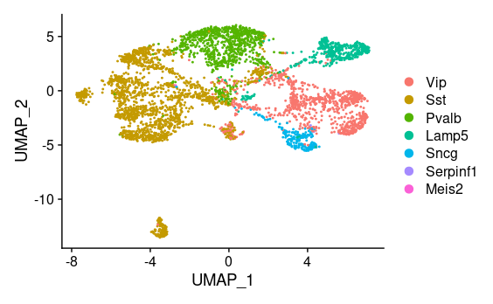
Comparing 2018 and 2020 datasets
2. Dimensionality reduction plots

Slide 36
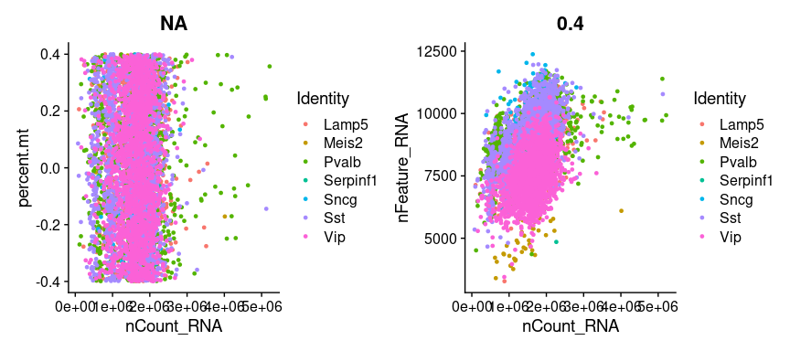
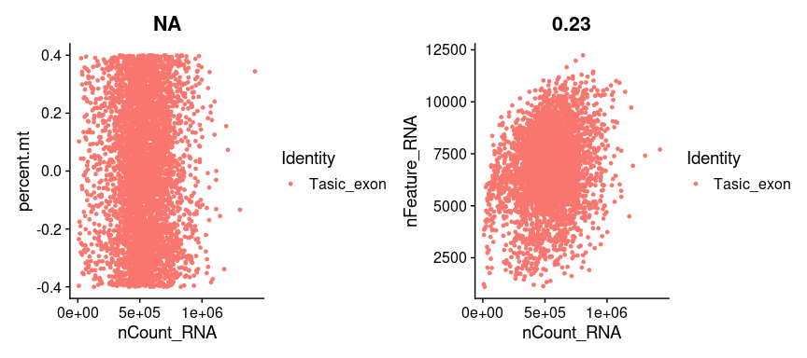
Comparing 2018 and 2020 datasets
Total n of genes found

